Slide 1
SSP Project Report
Mianzhi Pan, Chao Chen, Nan Tang

Slide 2
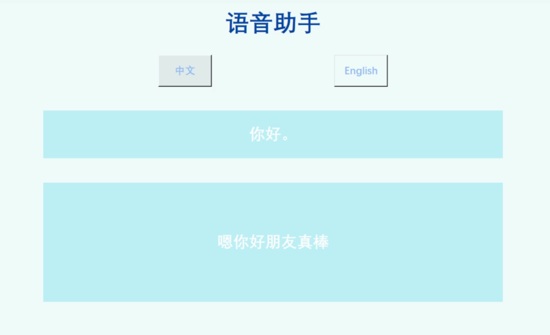
Features
Speech to text:
The wakeup word and sleep word
Speech recognition: Vosk
Punctuation mark: paddlehub, punctuator
NLU
Text to speech
Pyttsx3
GUI
Tkinter

Slide 3
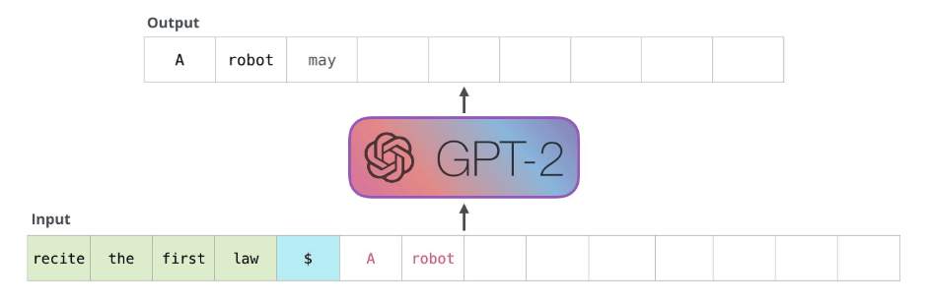
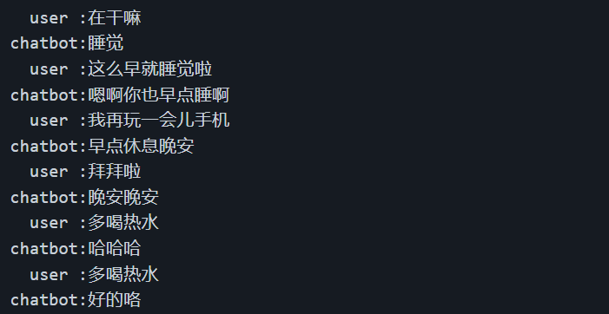
Natural Language Understanding Module
An end-to-end conversation model based on GPT2-chitchat.
GPT2 is a transformer-based large language model.
GPT2-chitchat further finetuned GPT on 500k Chinese chatting corpus.
Train model on movie-topic dialogue corpus proposed in [1].
GPT2 model
Chat examples of GPT2-chitchat
[1] Su, Hui, et al. "Moviechats: Chat like humans in a closed domain." Proceedings of the 2020 Conference on Empirical Methods in Natural Language Processing (EMNLP). 2020.

Slide 4
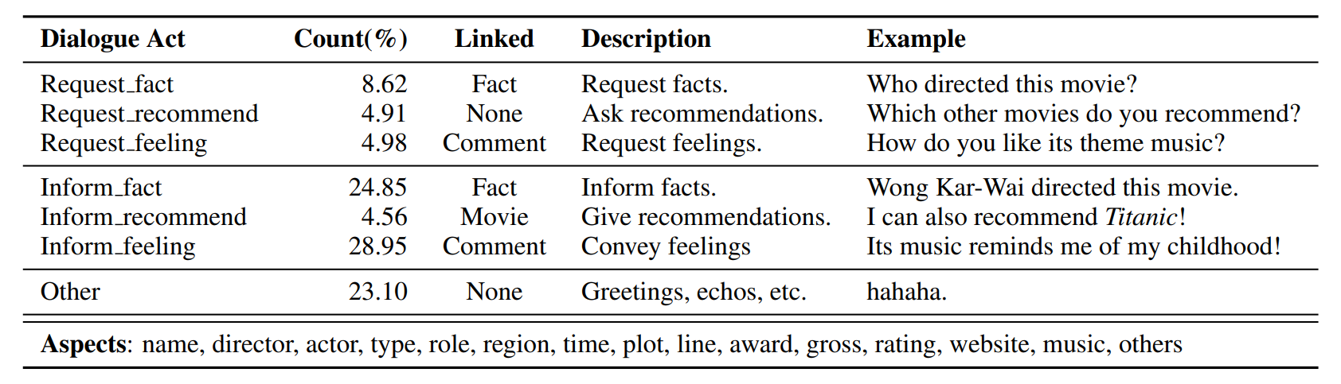
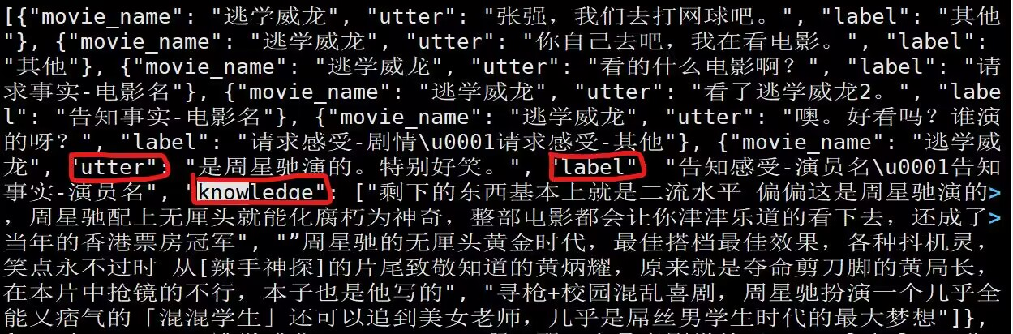
Natural Language Understanding Module
Dataset
246,141 dialogues
Crowd-sourcing dialogues
annotating dialog acts and entities
linking utterances into grounded knowledge (may not exist)
Dialog acts
Dataset example

Slide 5
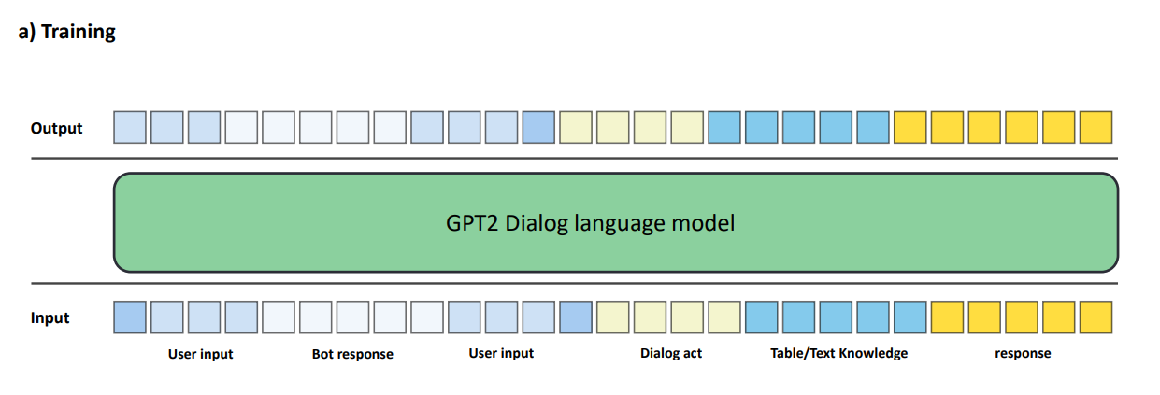
Natural Language Understanding Module
Training process
Concentrate history dialogue, dialogue act and knowledge
Predict the next token

Slide 6
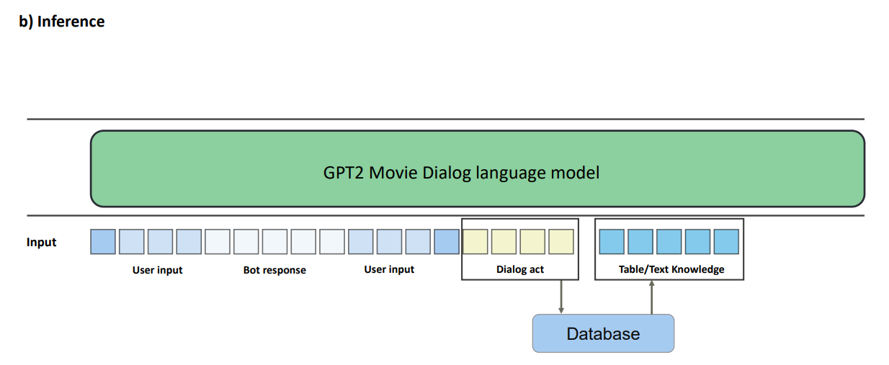
Natural Language Understanding Module
Inference process
Input history dialogue (Can add act, knowledge from external database to further improve the performance)
Predict the reply in auto-regressive manner

Slide 7
Limitations
The time cost in recognition and plus punctuation marks can be reduced.
The whole system is still single-threaded.
The vosk model we use is not the best model to recognize speech.
We have not achieved the conversation of agent in English.
The performance of our NLU model can be improved.

